Slide 1
Murach’s C# (8th Edition)
Chapter 2
How to design a Windows Forms app

Slide 2
Objectives
Applied
Given the form design and property settings for a simple app, use the Form Designer to design the form.
When necessary, rename the form, project, and solution files for an app.
Customize the Visual Studio environment for use with C# by setting the startup and development settings options.

Slide 3
Objectives (continued)
Knowledge
Describe the use of the Toolbox and Properties windows.
Describe the Name and Text properties for a form or control.
Describe the Enabled, ReadOnly, and TextAlign properties for a control.
Describe the way you:
Adjust the tab order for the controls on a form
Set access keys for controls
Set the default buttons for the Enter and Esc keys for a form

Slide 4
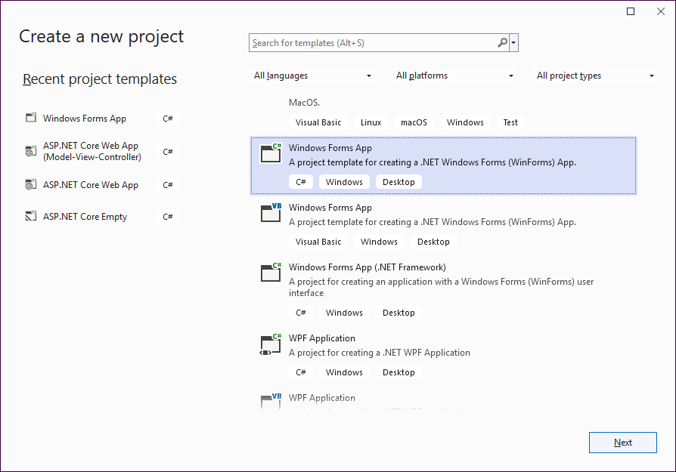
The Create New Project dialog

Slide 5
How to change the startup options
Use the Tools→Options command
Select the General category under the Environment group.
Select an option from the “On startup, open” drop-down list.

Slide 6
How to change the development settings options
Select the Tools→Import and Export Settings command.
Select “Reset all settings.”
Select “Yes, save my current settings” and the “Visual C#” option as you step through the wizard.

Slide 7
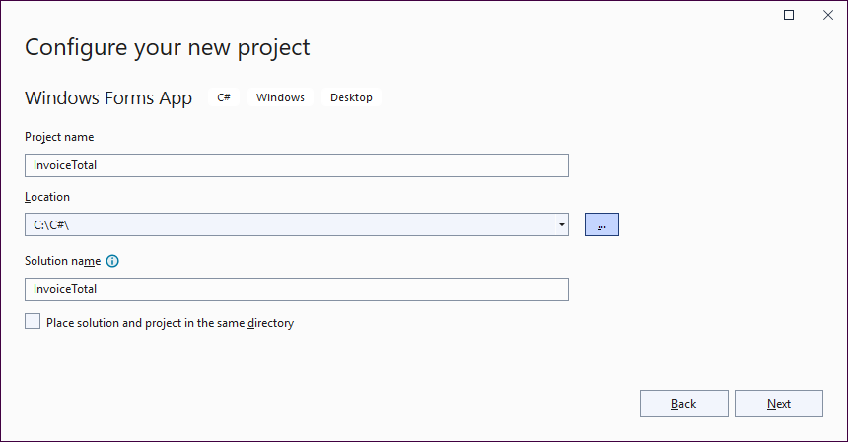
The Configure Your New Project dialog

Slide 8
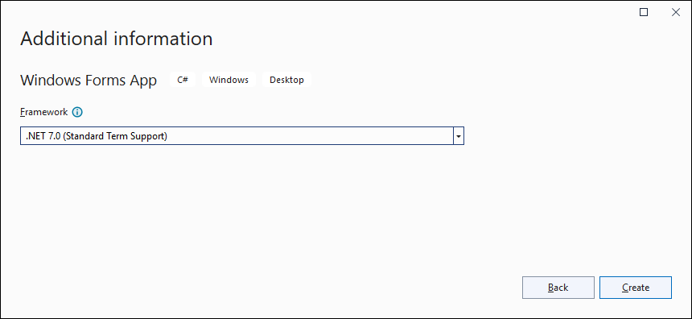
The Additional Information dialog

Slide 9
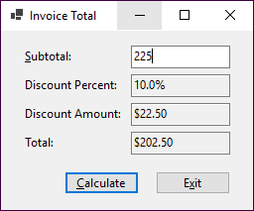
The Invoice Total form

Slide 10
The controls the Invoice Total form uses
Labels
Text boxes
Buttons

Slide 11
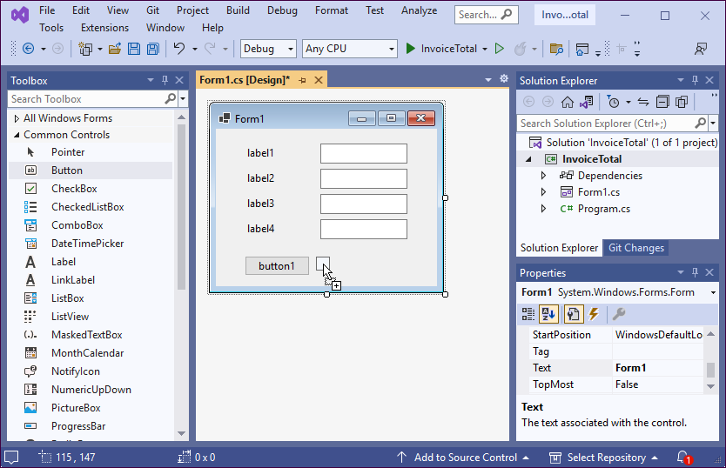
The Form Designer after some controls have been added to the Invoice Total form

Slide 12
Skills that you need for working with controls
Add a control to a form
Move a control
Size a control
Select a group of controls
Align, size, or space a group of selected controls
Change the size of a form
Adjust the tab order for the controls on a form

Slide 13
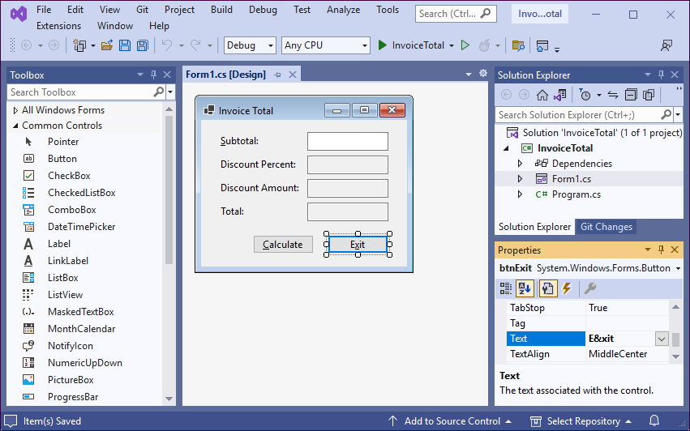
The Form Designer after the properties for the Invoice Total form have been set

Slide 14
Properties for forms and controls
Properties for both forms and controls
Name
Text
Other properties for forms
AcceptButton
CancelButton
StartPosition
Other properties for controls
Enabled
ReadOnly
TabIndex
TabStop
TextAlign

Slide 15
How to adjust the tab order for a form
Change a control’s TabIndex property.
Set a control’s TabStop property to False if it shouldn’t receive the focus.

Slide 16
How to set access keys
In the Text for a control, place an ampersand right before the letter for the access key.
If you set an access key for a label, the access key will take the user to the text box that follows the label in the tab order.

Slide 17
How to set the Enter and Esc keys
Set the AcceptButton property of the form to the button that will be activated if the user presses the Enter key.
Set the CancelButton property of the form to the button that will be activated when the user presses the Esc key.

Slide 18
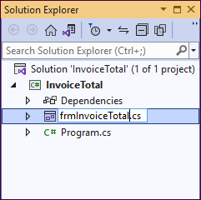
The Solution Explorer as a form file is being renamed

Slide 19
How to rename a file, project, or solution
Right-click on it in the Solution Explorer window, and select the Rename command from the shortcut menu.
Or, select the file, project, or solution in the Solution Explorer and press F2.

Slide 20
How to save a file, project, or solution
To save all files and projects, use the Save All button in the Standard toolbar or the Save All command in the File menu.
To save a file, project, or solution, use the Save button in the Standard toolbar or the Save command in the File menu.

